Slide 1
Classification & Text Generation of Coursera reviews
Notes:
Hi all, today I am going to present my project on Coursera review.
The first part will be about classification while the 2nd part will be on Text Generation using RNN

Slide 2
Problem Statement
Popularity of MOOCs in recent years…
1) Classification of reviews with ratings = 5 and without
2) Character-based Text Generation using RNN models
…Understand & improve further
Notes:
Based on the 2 datasets from Kaggle.
I would like to do classification modelling on reviews with rating = 5 and without 5
Also, generate reviews using Recurrent Neural Network. There has been a rise of fake-generated reviews found on yelp and Amazon, hence I am interested to explore this.

Slide 3
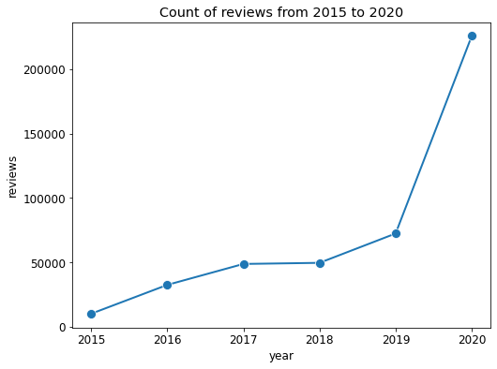
Coursera reviews over the years
Notes:
As we can observe, there has been a surge in Coursera reviews in 2020

Slide 4
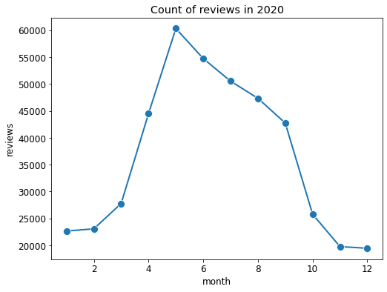
Coursera reviews in 2020
COVID-19 Global lockdown
Notes:
And look at March 2020. Actually, this coincides with the Covide-19 Global lockdown.
Moving on to the main topic

Slide 5

Overview
Data Cleaning
Translation
Exploratory Data Analysis
Classification Models
Text Generation Modelling
Notes:
This is my Capstone’s Project Overview
Data Cleaning,
Translation using a combination of NLP libraries
EDA
Classification Models which I will discuss briefly
AND text Generation Modelling which I think is the most interesting and is the focal point of my project

Slide 6
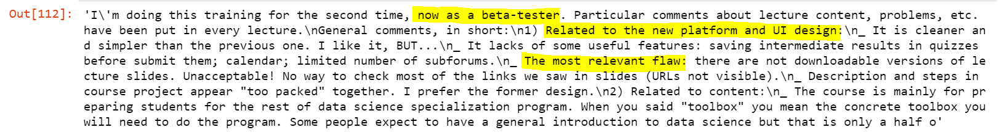
Data Cleaning
Drop reviews by beta-testers
Merge 2 Datasets from Kaggle
Drop duplicates & word count < 5
Translation…
Notes:
I merged 2 datasets
Removed duplicates and reviews with low word counts
Dropped reviews by beta testers
- Now I move to translation

Slide 7
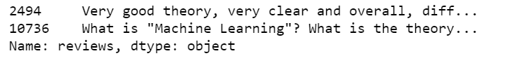
500 rows at a time due to API limit
Translation
Step 02
Step 04
nltk.corpus find not english reviews, 20k rows
google_trans_new, a free python API for google translate
Step 01
Step 03
Step 05
Regex is used to clean up text
SpaCy is used to detect the different languages
Concatenate back to dataframe
Left with 400k rows
Notes:
Regex to clean up text
Nltk corpus to find not English reviews
SpaCy to detect languages and group them together
Translate using google_trans_new
Concatenate back to a dataframe
That how I translate

Slide 8
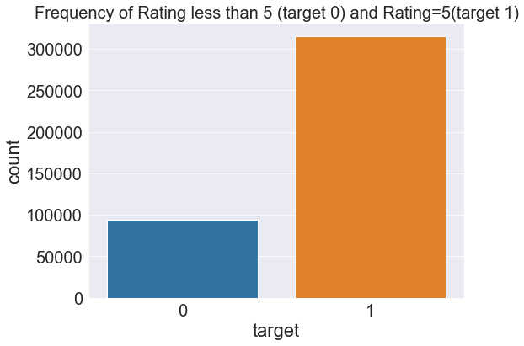
EDA - Frequency of rating 5 reviews
Baseline Accuracy : 77 %
Notes:
Now, moving on to EDA.
I found that 77 % of the reviews are have rating 5.
While the Remaining reviews are less than 5.
Do note that 77% is my baseline accuracy and this is a binary classification

Slide 9
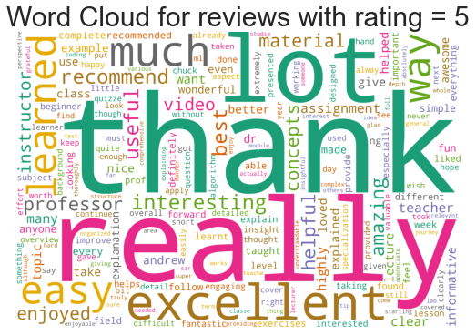
EDA - wordcloud
Notes:
I also plotted wordclouds for reviews with rating = 5
With a quick glance, U can see many positive words like thank, excellent , easy

Slide 10
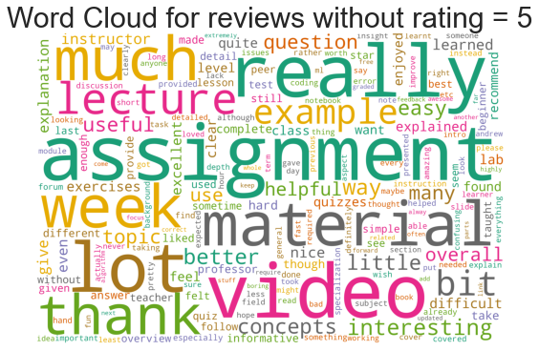
EDA - wordcloud
Notes:
While for wordclouds with rating less than 5?
You see a lot of words related to course content.
For example, material, lecture, assignment

Slide 11
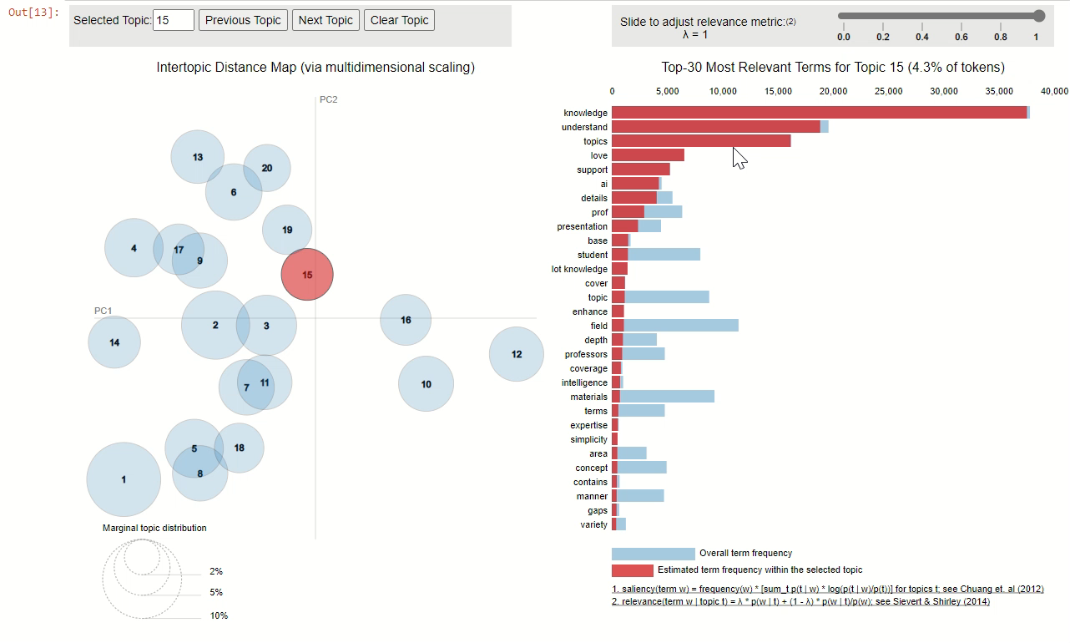
EDA - pyLDAvis
Notes:
I Also tried to find topics from pyLDAvis however it is mainly Course material or expressing gratitude to the course instructor
I didn’t find it to be conclusive so it was part of EDA process

Slide 12
Preprocessing before modelling
Stop words: name of institution
Porter Stemmer to stem words
Count Vectorizer: 4000 max features
ngram_range=(1,2)
1
3
5
2
4
6
Stop words: name of courses
Train_test_split
Classification models…
Notes:
I removed stop words which come from the instituition name. course name
- Stem the words, train_test_split, count_vec and now into modelling

Slide 13
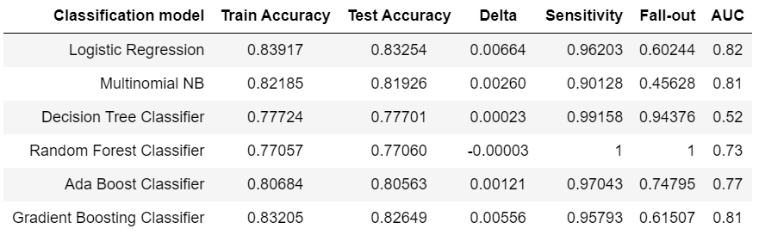
Classification model scoreboard
Notes:
Based on the above Classification model Scoreboard,
All of the classification models have classification score same or better than the required Baseline Accuracy of 77%
Descision Tree Classifier & Random Forest Classifier performed poorly compared to other models for this dataset, this is based on the accuracy scores are 77% and both models have high Fall-out rate (false positive rate) predict reviews to be mainly either False positive or True positive which predict to be target=1 reviews. target=0 reviews were not correctly classified as compared to other models.
Ada Boost Classifier & Gradient Boosting Classifier both models performed better with higher accuracy scores and but the Fall-out rate is not the lowest.
Logistic Regression & Multinomial NB produced high accuracy scores and Multinomial NB produced the lowest Fall-out rate at 45% compared to the other models.
Hence, Multinomial NB is chosen as the best model to classify target=1 reviews and target=0 reviews for this dataset.

Slide 14
Misclassified posts – False positives
“amazingli help shape broad much impress inspir style whole learn astonish improv broadli let explain assign week dr deni ask writer quit thing gave opportun previou write childhood parent kingartin teacher help lot assign quit amaz miracl help revis…”
… multipl vs short answer vs improv score significantli pass fail distribut reflect bell curv distribut interestingli tri mid term still saw failur rate expect someth requir fail prove capit wish found better way sever lectur hour commun instruct howev prove much valuabl unexpectedli failur rate term test class respond kind lectur fail term test almost drop anoth taken class encourag stay finish came treasur compliment taught anyth want
Notes:
On observing the word frequency in texts that are misclassified as target=1 reviews where rating = 5.0, these high frequency words also appear in the actual target=1 review hence many of the classification model have a high fall-out rate, with Multinomial NB having the lowest fall-out

Slide 15
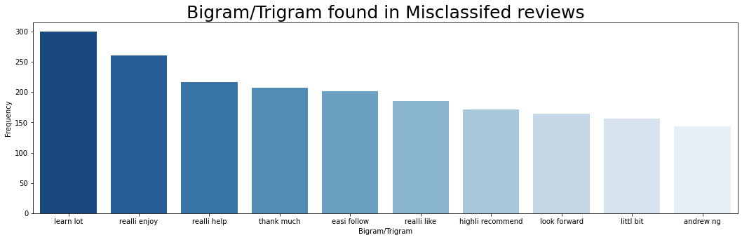
Bigrams in Misclassified reviews

Slide 16
Text Generation of Coursera reviews
Using RNN
Notes:
- Now, moving on to the main part of my Capstone Project
- Text Generation of Coursera Reviews

Slide 17
Char-based Text Generation
What type of reviews?
Preprocessing
Initial Model Topology
Tuning
Final Model Topology
Evaluation

Slide 18
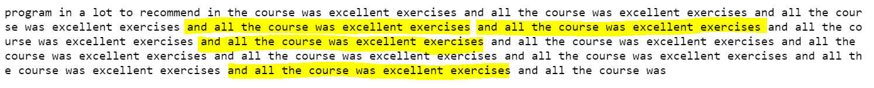
What type of reviews?
rating = 5
‘Python for Everybody’ course
Txt format
> 30 words
Notes:
What kind of reviews ?
Positive reviews with rating = 5
Most reviewed course ‘ Python for EveryBody’
In Txt format
More than 30 words, because if the text is not diverse enough I will generate text like this

Slide 19
Preprocessing
Total 1.2 million chars
36 unique chars
Mapping chars
Contents Title
Unique char to numbers & vice-versa
You can simply impress your audience and add a unique zing.
Notes:
Now moving on to Preprocessing
There are 1.2 million characters in total
And we are trying to predict which of the 36 characters are produced
So note that this is a multiclass classification after reading a sequence of text
First, we map the unique characters to numbers

Slide 20
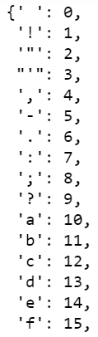
Mapping chars
Char to integer
Notes:
Text of 1208987 chars
36 unique chars
Text split into overlapping sentences of 100 char with 3 steps
Every last 3rd char = target

Slide 21
Preprocessing
Text length 1.2 million chars
36 unique chars
Overlapping Sentences
Length 100 chars with step of 3 char
Mapping chars
3-D matrix
Unique char to numbers & vice-versa
X.Shape = (402963, 100, 36)
y.Shape = (402963, 36)
Notes:
Then I create overlapping sentences with length 100 characters and steps of 3 characters
This will be fed into my Recurrent Neural Network but in 3-d Matrix form just like the earlier projects presented by others

Slide 22
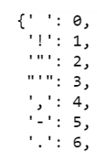
Preprocessing
1 sentence = 100 chars
target
3 characters per step
≈ 402,963 sentences & 402,963 targets
Mapped into 3-D Matrix
X.shape (402963, 100, 36)
y.Shape (402963, 36)
Notes:
So the string of text are sliced into sentences of 100 characters
With mapping of 3 characters at a time and as this is mapping with step of 3 characters, every last third character in my sentence is my target
This results in 402k sentences and 402k targets
And from the mapping that we did earlier? It helps to map 1 to the different position in the matrix
This this is X shape and y shape

Slide 23
Preprocessing
Text length 1.2 million chars
36 unique chars
Overlapping Sentence
Length 100 chars with step of 3 char
Train_test_split
Shuffle = False
Mapping chars
3-D array
Contents Title
Unique char to numbers & vice-versa
X.Shape = (402963, 100, 36)
y.Shape = (402963, 36)
Modelling
Batch size = 128
Input shape=(100,36)
You can simply impress your audience and add a unique zing.

Slide 24
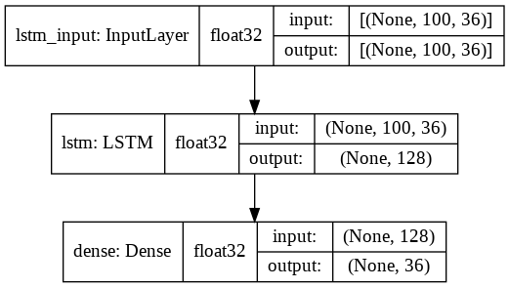
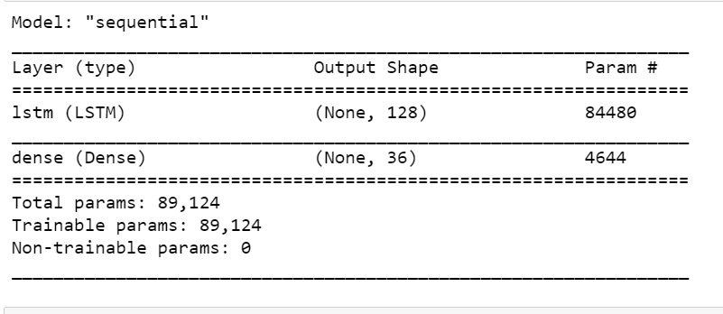
Initial topology
89k params
Activation = ‘softmax’
Predict 1 of 36 characters

Slide 25
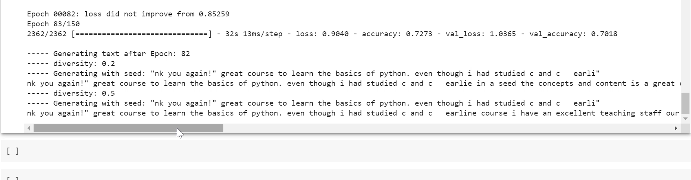
Generation Process
Seed text
Trained Neural Network will read seed text
Predict 1 of 36 characters

Slide 26
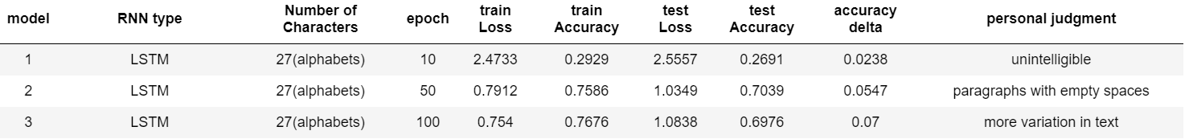
Tuning - Epoch
Epoch 10
Epoch 50
Epoch 100

Slide 27
Tuning
27 chars to 36 chars (LSTM)
27 chars to 36 chars (GRU)

Slide 28
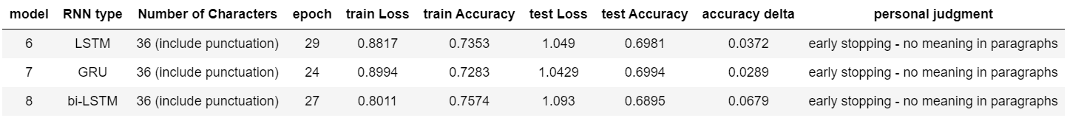
Tuning
Try Early Stopping (stops around 20 to 30 epoch)

Slide 29
Text Generated not ideal…
“the unreasonable effectiveness of recurrent neural network”
by Andrej Karpathy

Slide 30
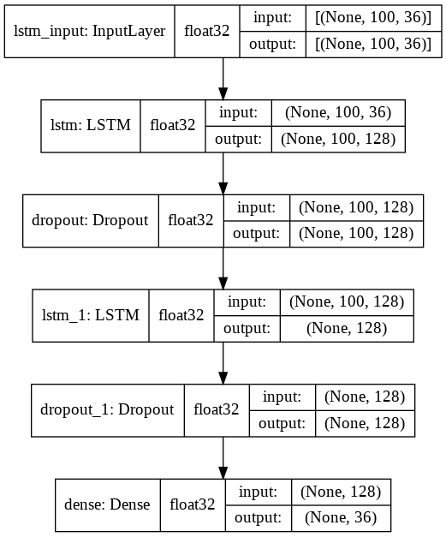
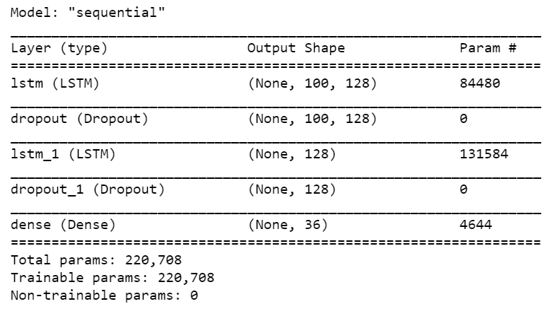







Final Model Topology
220k params
Additional LSTM layer with Dropout 0.2

Slide 31
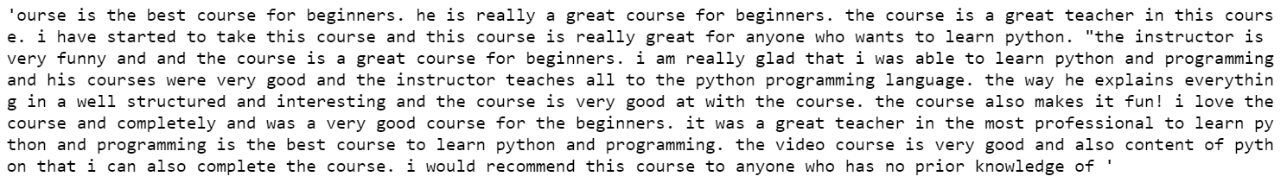
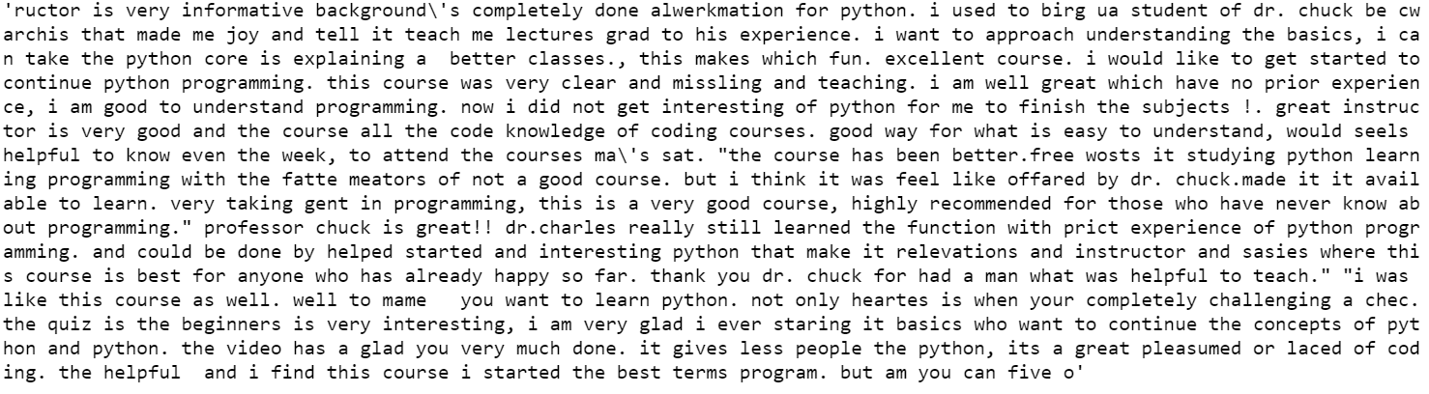
Training on entire Dataset
1000 chars
2000 chars
Notes:
Text of 1208987 chars
36 unique chars
Text split into overlapping sentences of 100 char with 3 steps
Every last 3rd char = target

Slide 32
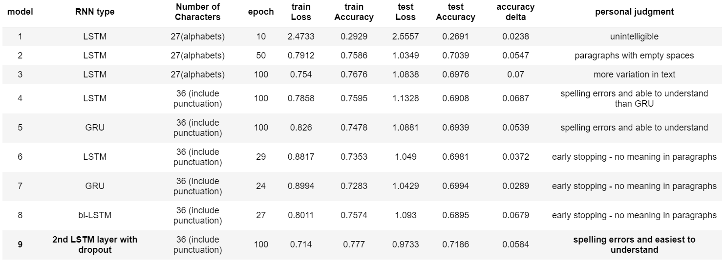
Evaluation

Slide 33
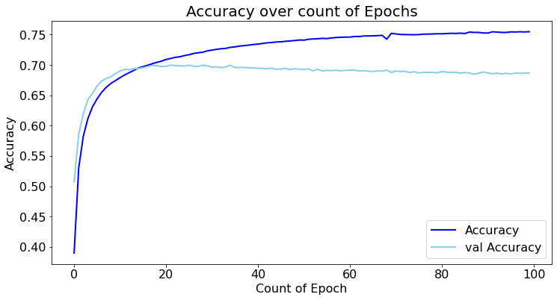
Accuracy

Slide 34
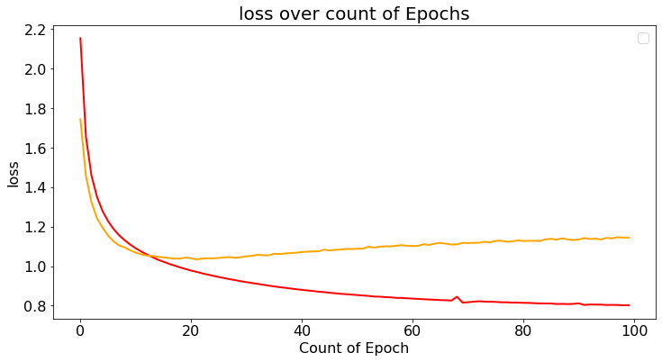
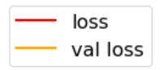
Loss

Slide 35
Conclusion
Fine – tune more
> epoch better in this case
can be used to generate fake reviews

Slide 36
References:
The Unreasonable Effectiveness of Recurrent Neural Networks by Andrej Karpathy
Text generation with an RNN tutorial from tensorflow.org
Character-level text generation with LSTM from keras.io
Text Generation With RNN + TensorFlow from section.io
Tutorial from Tanner Gilbert
Machine Learning Mastery
predictivehacks

Slide 37
Questions?
Notes:
Number of characters
Count of Epoch
RNN memory cell type
Early Stopping

